Slide 1

Final Intern Presentation
Caitlin O'Callaghan and Meredith Ju

Slide 2
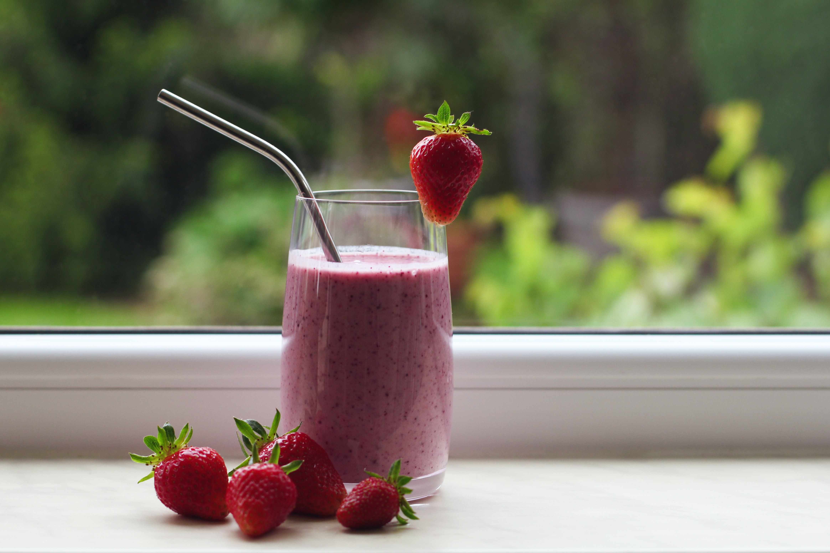
Intro

Slide 3


Introductions
Caitlin O’Callaghan
Meredith Ju
Explore Intern on the Answers and Segments team
Rising Junior at UT Austin
Explore Intern on the Answers and Segments team
Rising Sophomore at Cornell

Slide 4
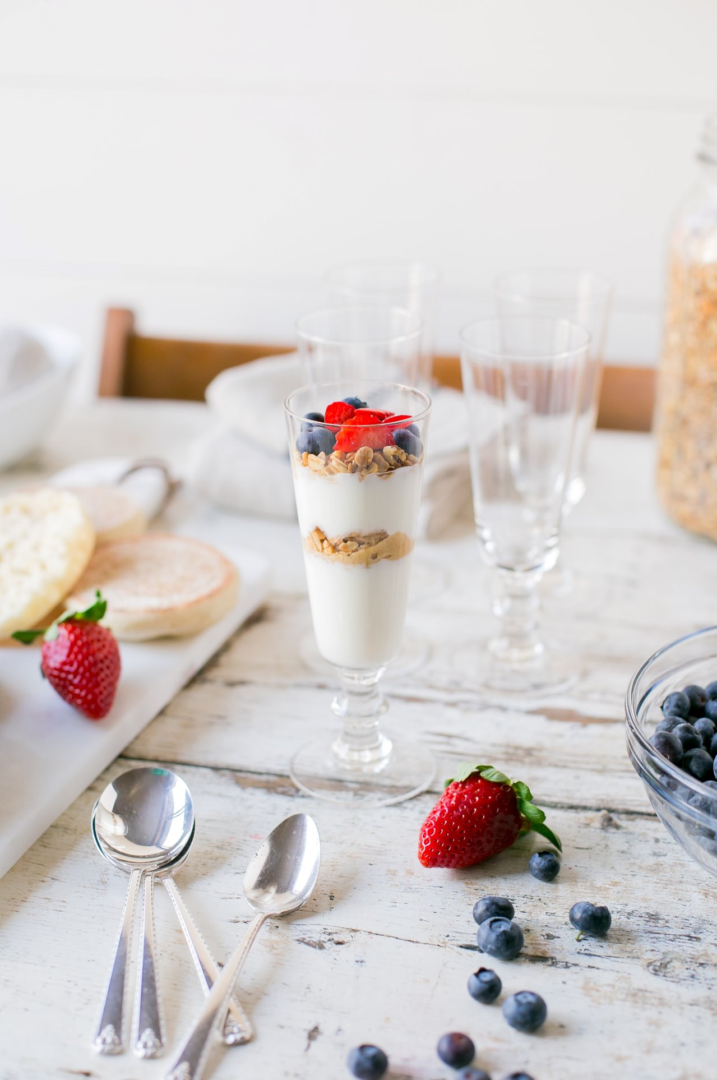
Dev Project

Slide 5
Background
The current pipeline uses a weekly snapshot
Our goal for the summer was to improve the freshness by switching to a snapshot that uses daily delta and maintain similar COSMOS resources
Freshness: Tier 0 data is originally updated every week instead of everyday

Slide 6
Metrics
Improve freshness using similar COSMOS resources
Tier 0: 1 week -> 1 day
Tier 1: 2 weeks -> 1 day
Tier 2: 1 month -> 1 day
A PN Hour is a Processing Node Hour, used to measure how well parallelized a job is
Token Allocation is the minimum number of processing units your job will need
Notes:
Freshness w/ similar cosmos resources

Slide 7
RetroIndex Snapshot
​The RetroIndex Snapshot is a look into the Servable Index on a particular day
A new "latest snapshot" will be produced once a week. Once a new snapshot is produced, the old one will be deleted
Current freshness is at minimum 1 week

Slide 8
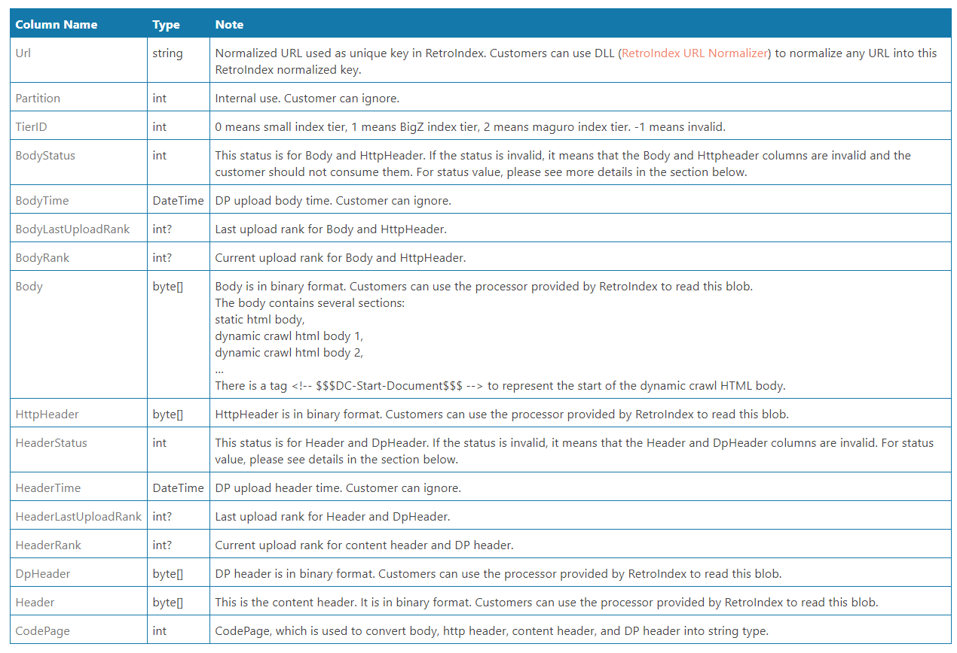
Daily Delta & Tiers
The RetroIndex Daily Delta is a structured stream created daily that contains added and updated documents in the past day

Slide 9
Daily Delta & Tiers
Tier | Name of Index Tier (document range) | Static Rank
Tier_0 | Precision Index (0 to 3B) | 595 <= rank <= 65535
Tier_1 | Precision Index (3B to 15B) | 105 <= rank < 595
Tier_2 | Precison Index (15B to 40B) | 38 <= rank <105
Tier_3 | For small set of domains | Rank <38

Slide 10
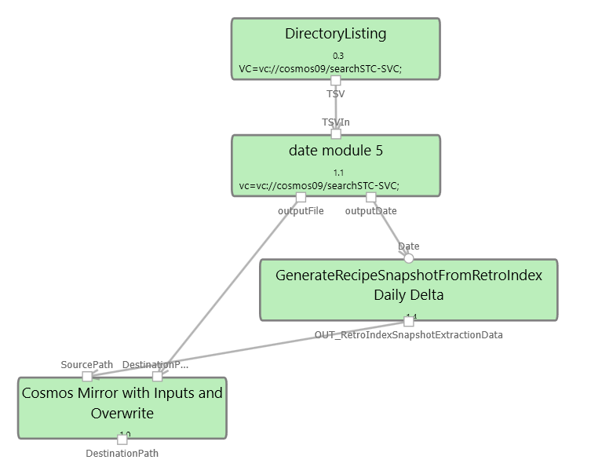
Schedule Daily Delta Run
We created a script to capture and process RetroIndex daily delta
We scheduled the script to run daily
Originally, we scheduled this experiment to later use it for generating the new snapshot

Slide 11
Updating Daily Delta Run
Since each day’s daily delta has 16 streams, we modified the experiment so that it waits for each of the streams to be ready before processing the data
We scheduled this to run twice a day in case the streams weren’t ready the first time
Once they are ready, we process them via the Generate Recipe Snapshot from RetroIndex module which will add fields we need such as HasRecipeMarkup

Slide 12
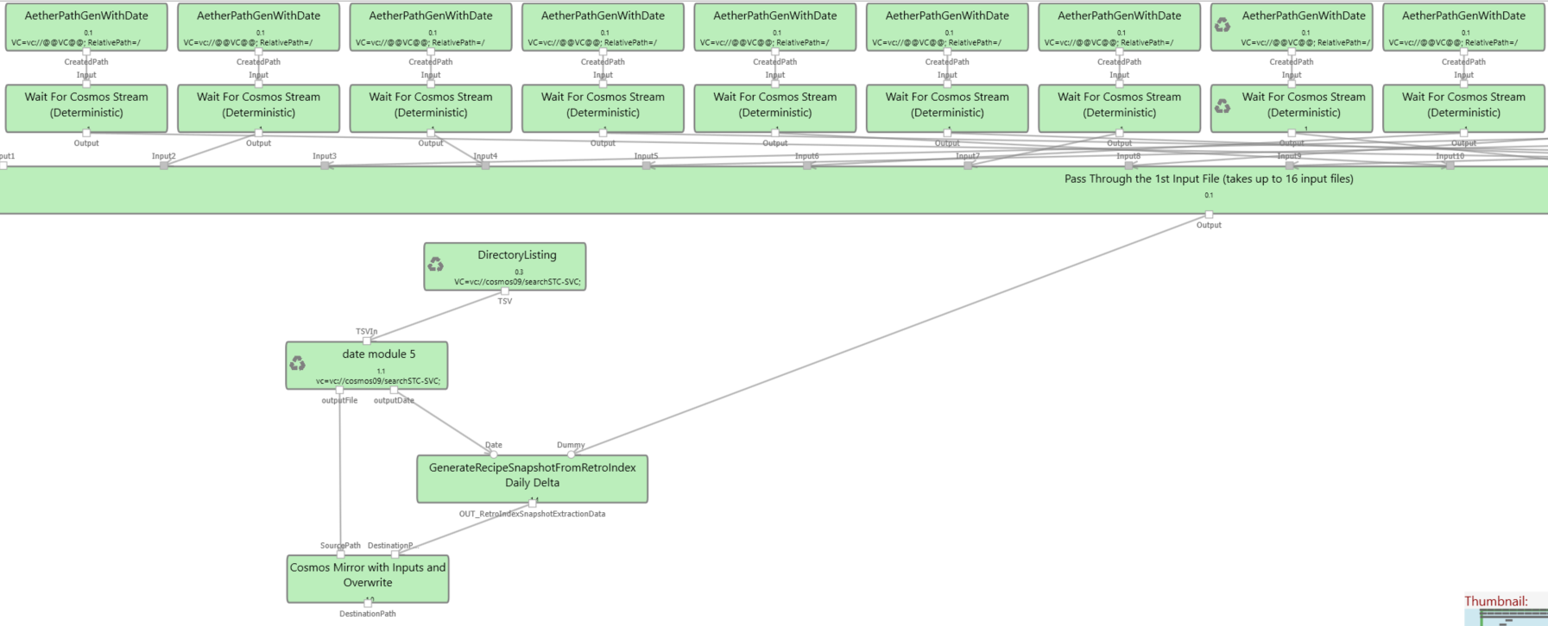
Updating Daily Delta Run

Slide 13
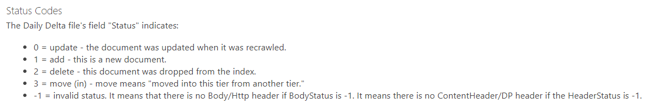
Find Dropped URLs
We discovered that BodyStatus and HeaderStatus fields in daily delta can indicate whether the content was added, removed, changed or invalid
We leveraged this to collect the dropped URLs (status of 2) from the daily delta each day when we do our daily delta run

Slide 14
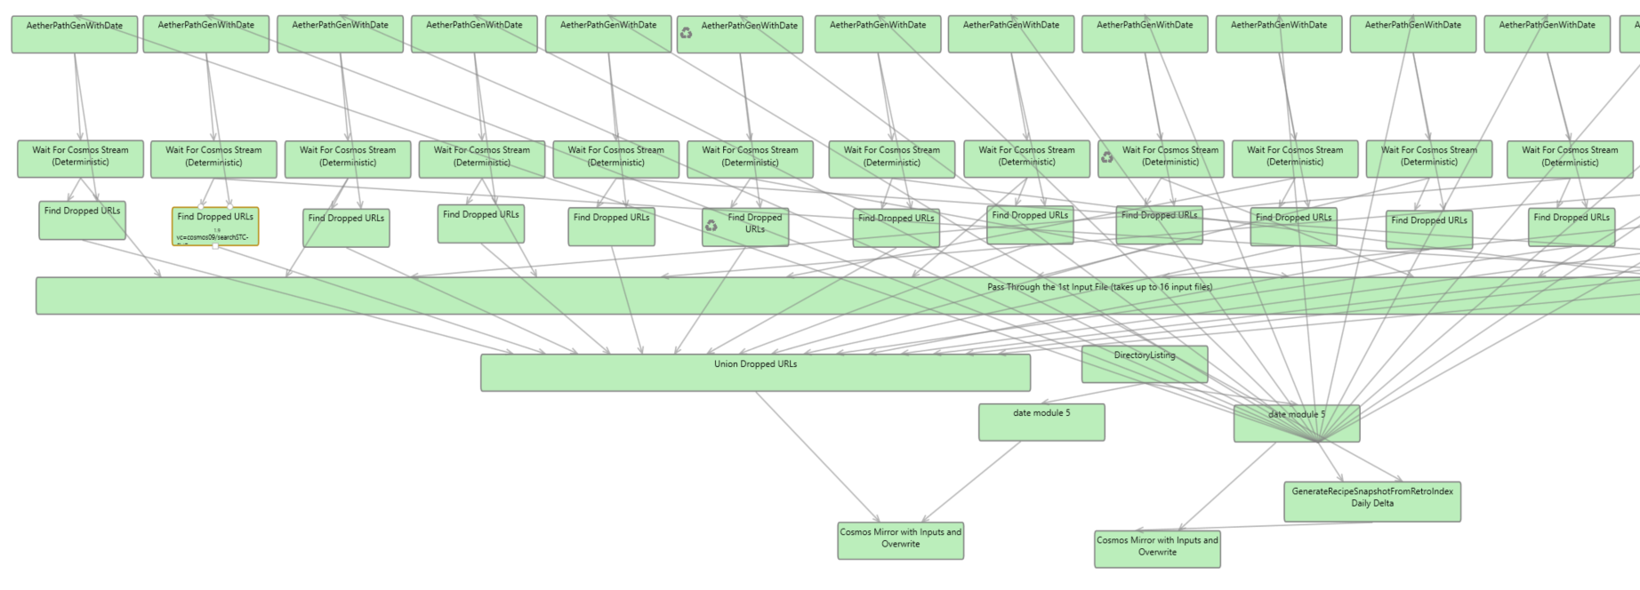
Find Dropped URLs

Slide 15
Weekly Snapshot Replacement
We wrote a script to combine 7 days of daily delta and the 7 days of dropped URLs we calculated, then remove the dropped URLs from the combined daily delta
We also added processing steps (PreSemanticExtraction and RecipePipeline… modules) to the daily delta before removing the dropped URLs

Slide 16
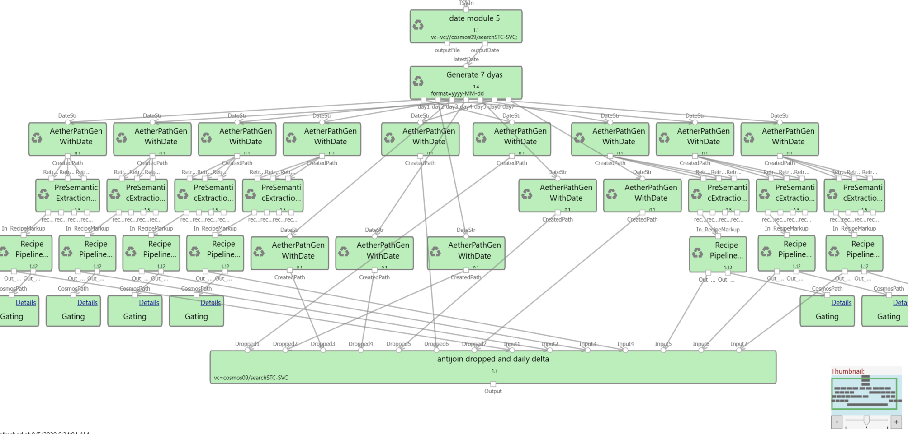
Full Snapshot Replacement 1.0

Slide 17
Verify Results
We performed a parity check on the unprocessed equivalent of our generated snapshot
We removed Urls according to their most recent status
 | Difference in URLs original and generated snapshot | % Difference
body -1 OR header -1 | -977, 284, 897 | -35.67%
body 2 OR header 2 | 764, 082 | 0.02%

Slide 18
Initial Daily Snapshot
Modified experiment to add daily delta (processed) every day
This way an updated snapshot will be available each day and the data will be more fresh
We only process daily info with BodyStatus and HeaderStatus != 2
and !=-1
Then we remove Urls with BodyStatus and HeaderStatus = 2 from the previous day’s snapshot, leaving urls
We add processed daily delta info to the previous snapshot to make the current one

Slide 19
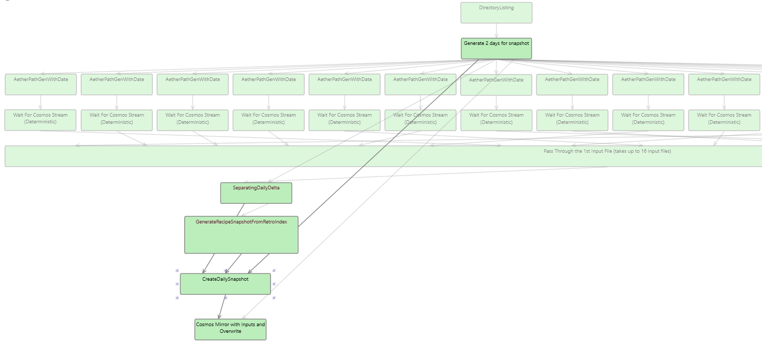
Initial Daily Snapshot

Slide 20
Final Daily Snapshot
We reached out to the RetroIndex team about the different statuses
Discovered that we need to handle the case where a status of -1 could mean invalid OR unchanged
We added logic to merge fields from the previous snapshot with the new snapshot depending on if the BodyStatus was -1 or if the HeaderStatus was -1
BodyStatus = -1 AND HeaderStatus = -1 is considered invalid and ignored

Slide 21
Final Daily Snapshot
Column Name | Type
Url | string
DocumentUrl | string
... | string
DocHtmlBody | string
... | string
HasRecipeMarkup | bool

Slide 22
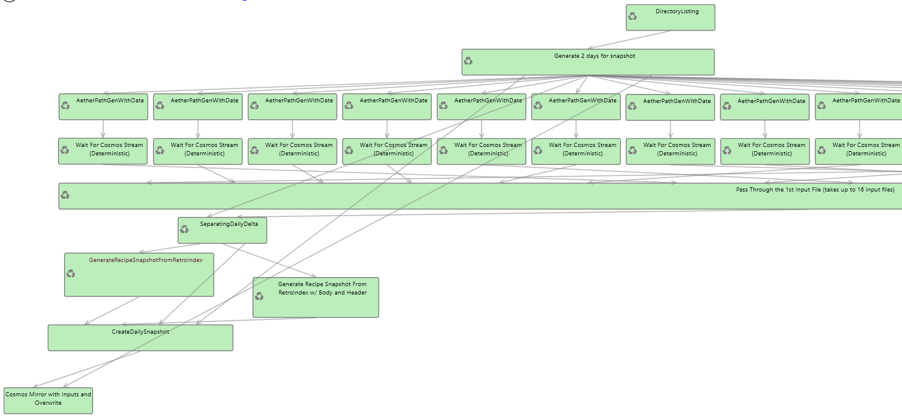
Final Daily Snapshot

Slide 23
Result
We successfully created an experiment to improve the freshness from on average 3.5 days, to an average of 1 day
We scheduled the experiment to run daily, combining the day’s daily delta into the snapshot
Our goal was to also maintain similar COSMOS resources, but improved the PN hours as well

Slide 24
Result
 | Original | New
Freshness | On average, 3.5 days | On average, 1 day
Tokens | 351 | 300
PN hours/day | 415 | 352
PN hours/week | 2,903 hours | 2,464 hours
Runtime | 2:13 hours/ week | 96 minutes/day (11 hours/week)
Notes:
https://sharepoint/sites/cosmos/team/economy/_layouts/15/WopiFrame2.aspx?sourcedoc=%7BF37B4562-1AA1-4621-A03C-FD4124C95089%7D&file=Why%20CPU%20Hours%20Not%20PN%20Hours.docx&action=default&DefaultItemOpen=1
https://microsoft-my.sharepoint.com/personal/alecb/Blog/Lists/Posts/Post.aspx?List=143673cd%2D4980%2D46e1%2Da3cc%2Ddd61fe0e3a1d&ID=15&Web=edf261ab%2D584a%2D4053%2Db6d6%2Dae2fe9dd196c

Slide 25
Schedule Snapshot Run Daily
We will catch the snapshot up to the most recent daily delta
Then schedule it to run twice a day awaiting daily delta completion

Slide 26
Related Documents
RetroIndex Daily Delta
RetroIndex Snapshot
Pipeline Consolidation Step1 (Web view)
Body and Header Status.xlsx
Our Experiment

Slide 27

PM Project

Slide 28
Background
Bing’s current experience includes touch filters regarding nutrition, top rated, and quick recipes
The experience also has a compare feature to see recipes’ info side by side
Our project sought to find users’ pain points and add features to improve the experience

Slide 29
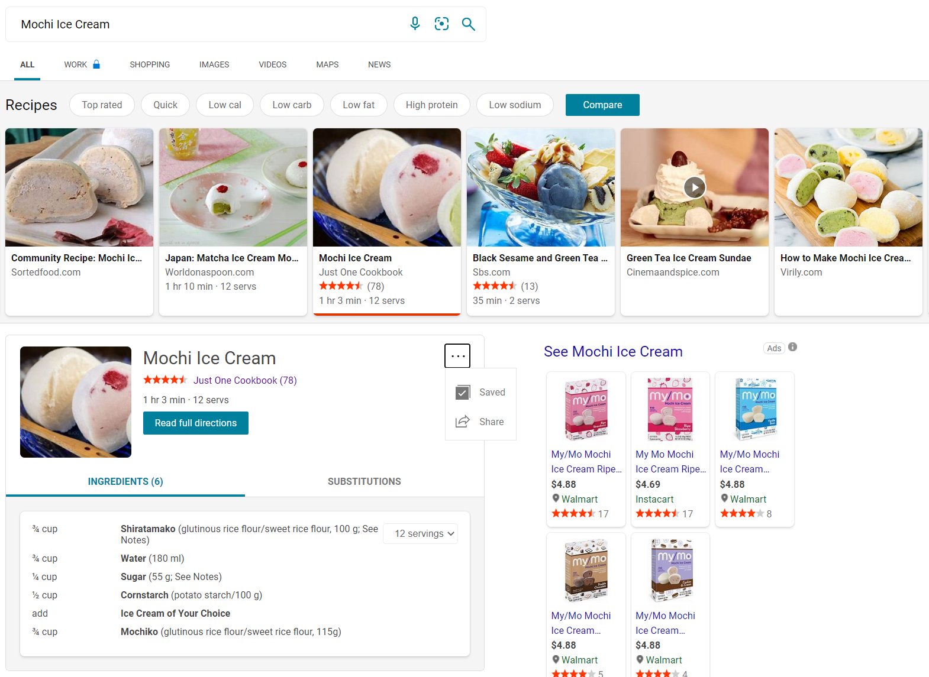
Current Experience
3 clicks to save
Can't navigate away to saved recipes easily

Slide 30
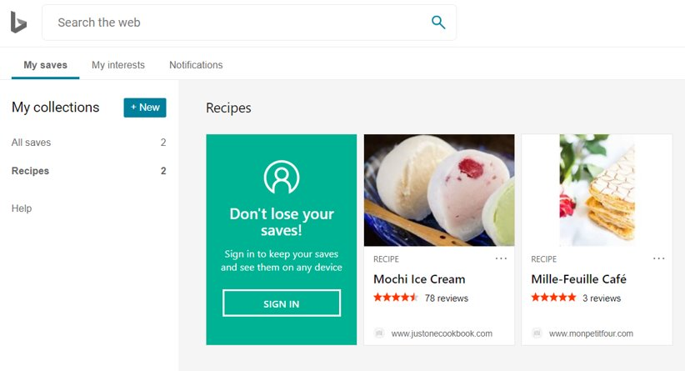
Current Experience
4 clicks to navigate to saved recipes
No differentiation among recipes (breakfast, dessert, drinks)

Slide 31
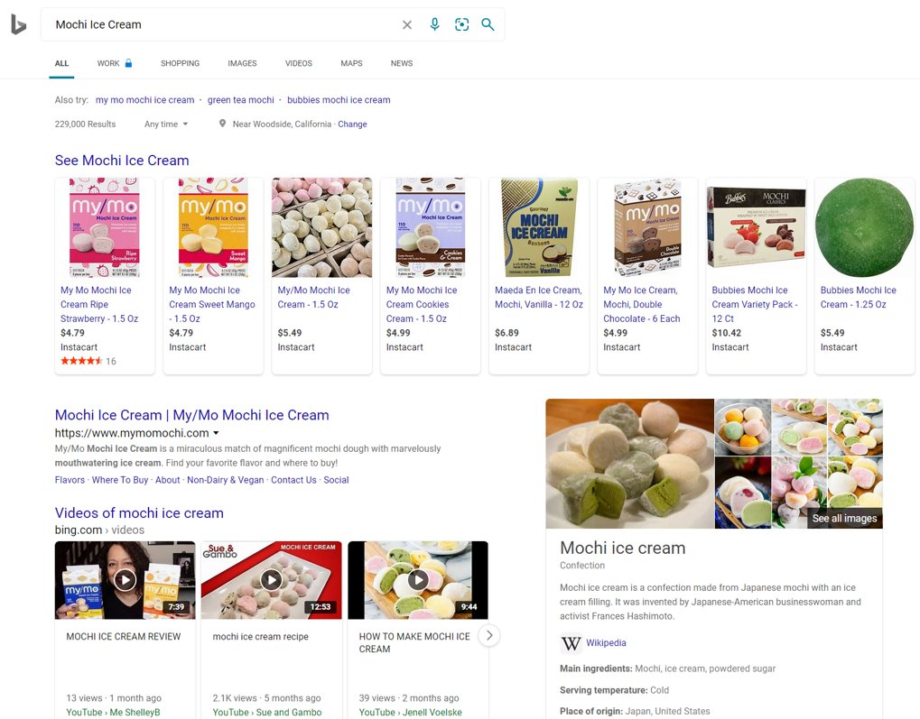
Current Experience
When user clicks on saved recipe, navigates to search results of the name of the recipe, but doesn't display relevant saved rich card

Slide 32
Overview EN-US
Competitive Analysis en-us
Feature Ideation en-us
Spec en-us

Slide 33
Competitive Analysis EN-US
Website Appearance and Experience
Saving Recipes
Ingredient Search
Allergens and Diet Filters

Slide 34
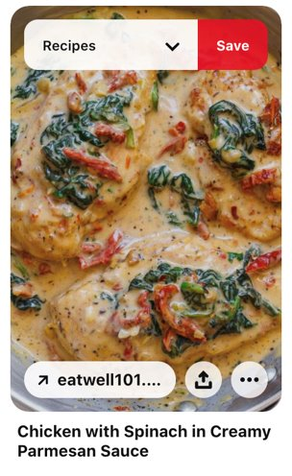
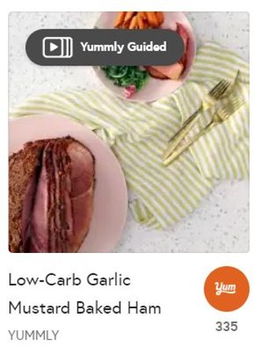
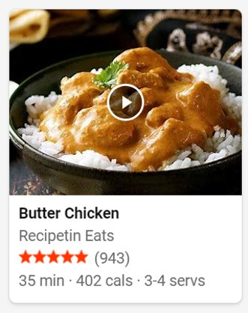
Competitive Analysis EN-US
Our Main Competitors
Yummly
Bing
Pinterest

Slide 35
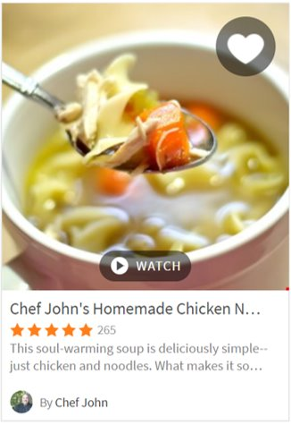
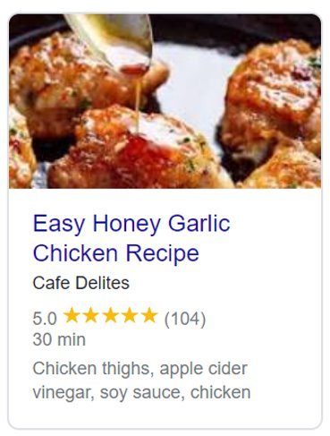
Competitive Analysis EN-US
Our Main Competitors
Google
AllRecipes

Slide 36

Competitive Analysis EN-US
Approx 32 million people in the US have food allergies
In a Microsoft study, 15% participants said that diet filters were the most useful feature on their preferred site
Each year, approx 45 million Americans go on a diet
In a Microsoft study, 10% participants found searching by ingredients to be the most useful feature on their preferred site
Competitive Analysis EN-US.pptx
Notes:
Each year, approx 45 million Americans go on a diet
22.8 million Americans follow a vegetarian-inclined diet
7.3 million Americans follow a vegetarian-based diet
1 million Americans are vegan
In a Microsoft study, 15% participants said that diet filters were the most useful feature on their preferred site
Approx 32 million people in the US have food allergies
Food allergies on the rise
childhood peanut or tree nut allergy appears to have more than tripled between 1997 and 2008
between 1997-1999 and 2009- 2011, food allergy prevalence among children increased by 50%
In a Microsoft study, 10% participants found searching by ingredients to be the most useful feature on their preferred site
Competitive Analysis EN-US.pptx

Slide 37
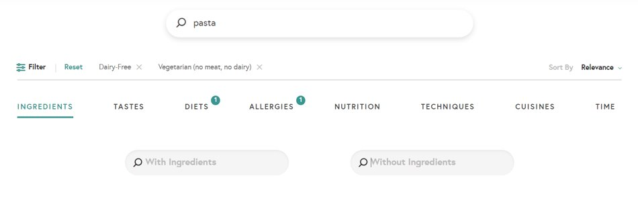
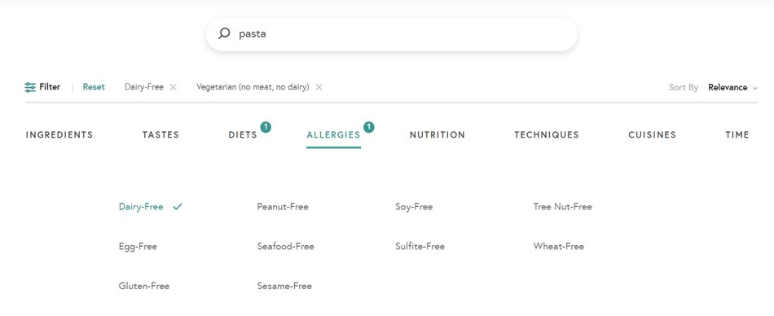
Competitive Analysis EN-US
Yummly
AllRecipes

Slide 38
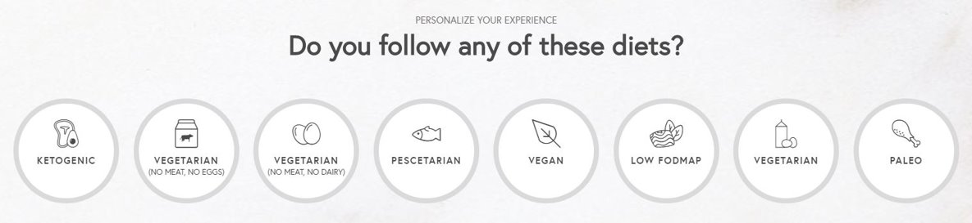
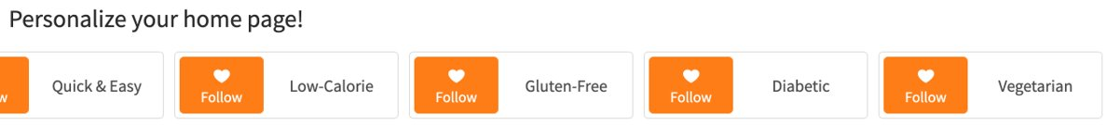
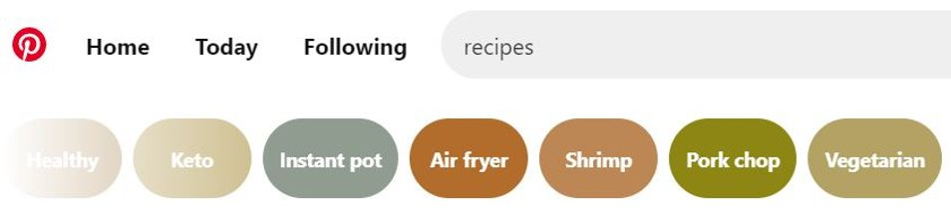
Competitive Analysis EN-US
Yummly
AllRecipes
Pinterest

Slide 39
Feature Ideation
Diet and Allergen Filter
Ingredient Search
Saving Recipes
Interactive Experience (Related Recipe Content)

Slide 40
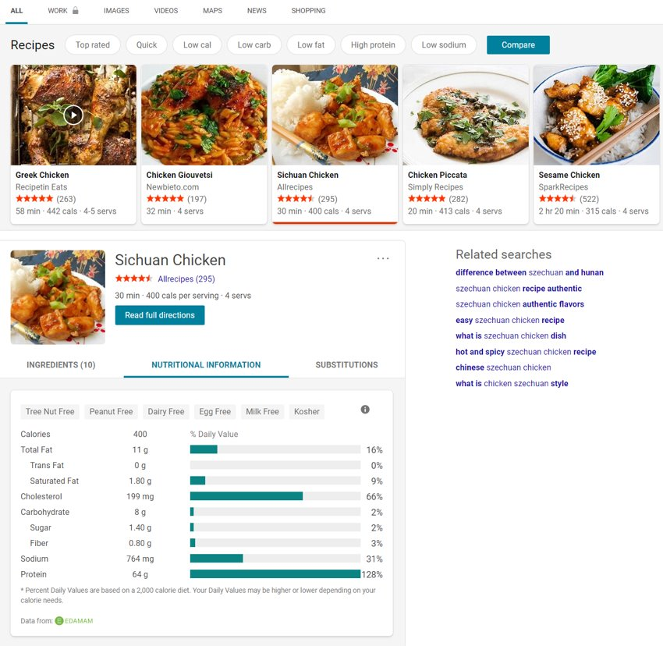
Diet and Allergen Filters

Slide 41
Diet and Allergen Filters
Feature proposals
Search for restrictions / allergens
Issue: user needs to know specific keyword
Drop down menu to browse through all restrictions / allergens
Different categories (like Yummly)
Click to expand a category
Easy to browse and saves space if you don’t need to use it
Possibility of saving user’s preferences

Slide 42
Ingredient Search
Feature proposals
Add ingredient search feature to current recipe experience
Ability to include and exclude ingredients in search
Can be useful for encompassing diet & allergen pain points
Useful for finding content with ingredients you already have

Slide 43

Specs
Notes:
Hehe it’s a tiramisu

Slide 44
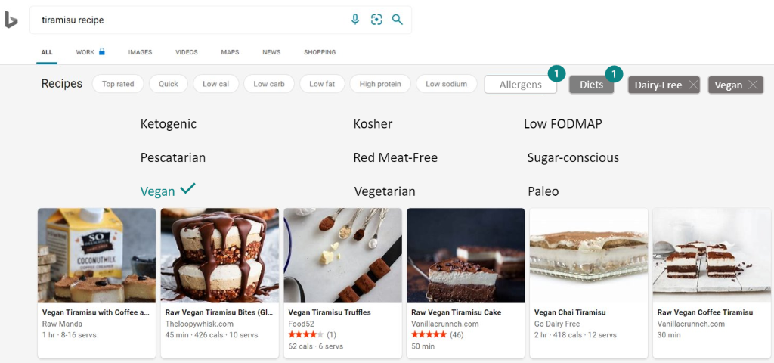
Specs/Mocks
Diet/Allergen Filter Spec (Web view)

Slide 45
Problem/Motivation
For people with food allergies it can be difficult to find recipe content quickly and easily that avoids their allergens.
Without a method of filtering out specific allergens, users must scroll until they happen to find a recipe without their allergen
This limits their options and the ability to weigh multiple options

Slide 46
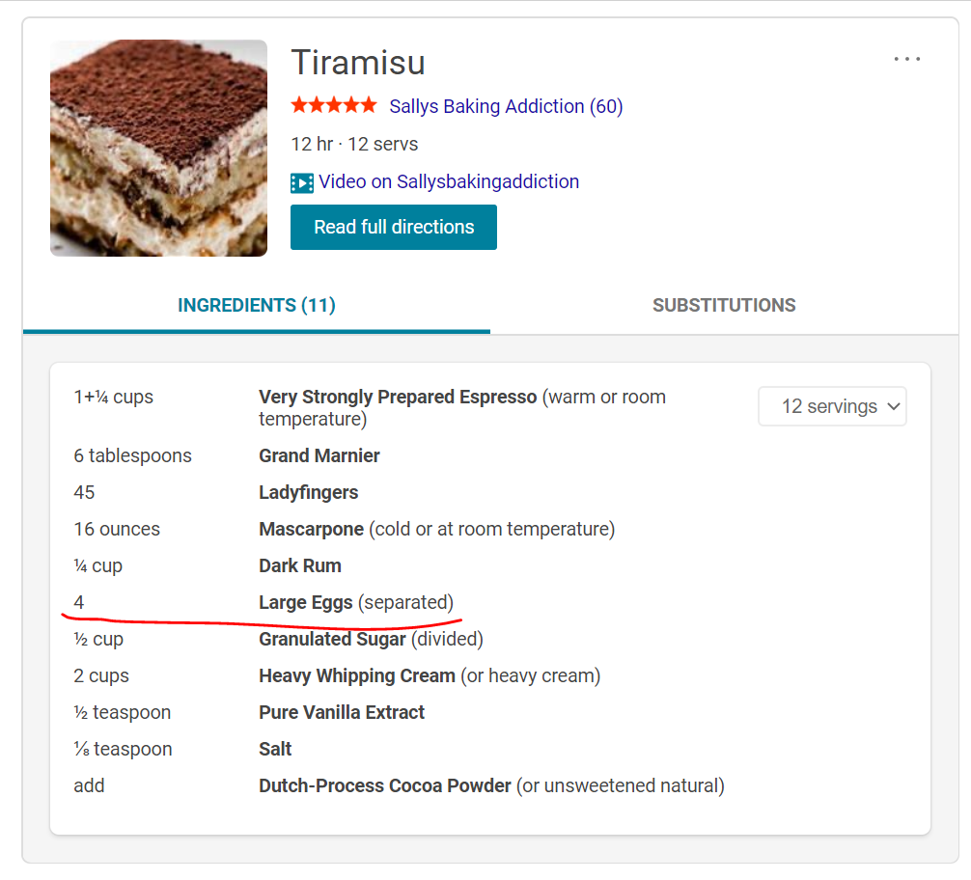
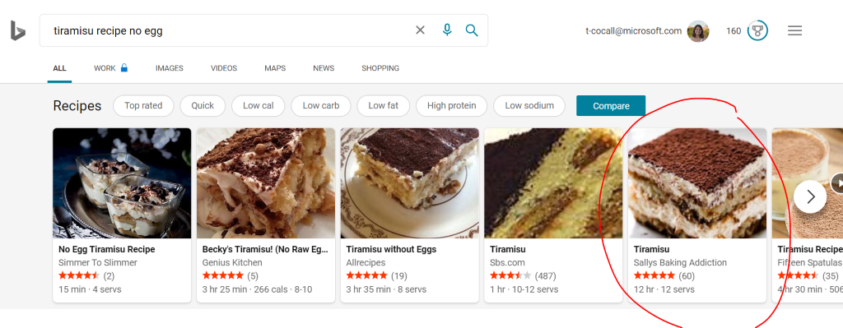
Problem/Motivation

Slide 47
Problem/Motivation
The current recipe experience does not give the ability to filter by common diets
Users must type in the search bar for the diet they follow, and this often leads to search results that specifically contain the word "vegetarian" or "paleo" even though mainstream recipes may also be vegetarian.

Slide 48
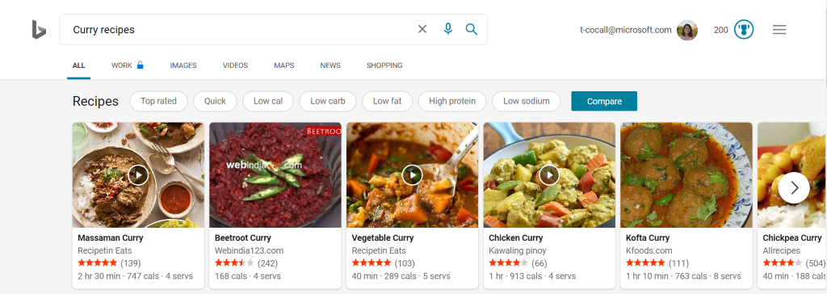
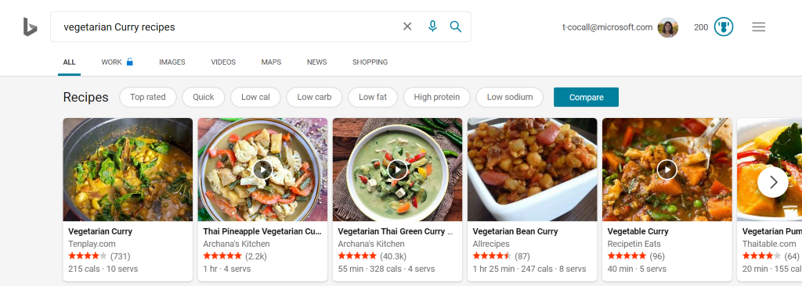
Problem/Motivation

Slide 49
Goal
No. | Goal | Pri.
1 | Allow users to specifically refine search based off allergen restrictions | P0
2 | Allow users to specifically refine search based off diet restrictions | P0
3 | Allow for multi-selection of filters | P0
The goal of adding diet and allergen filters is to create a more relevant and engaging experience for users when searching for recipe content. This will be accomplished by:
Non-goal: filtering out ingredients that a user dislikes

Slide 50
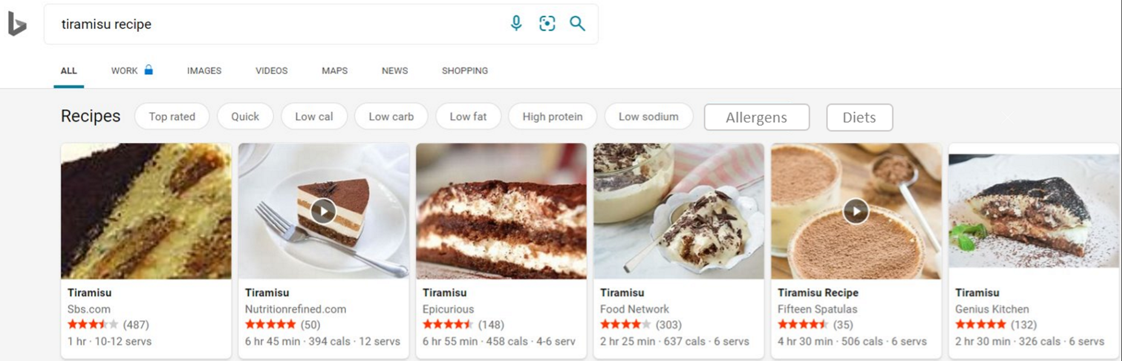
User Scenarios
As a user, I can filter recipes based on my allergen restrictions (P0)
I can navigate to the allergens tab and choose which allergens I have

Slide 51
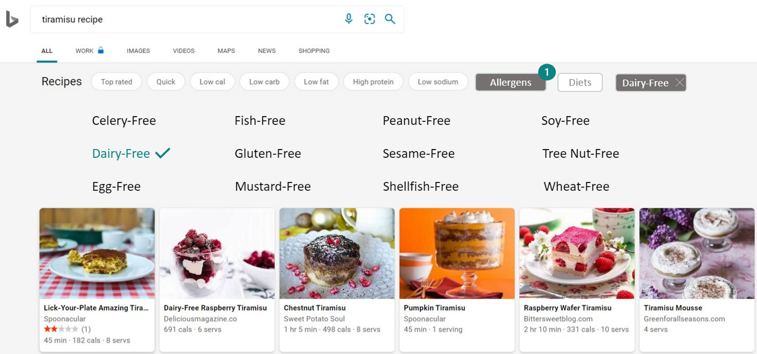
User Scenarios
As a user, I can filter recipes based on my allergen restrictions (P0)
b. We chose 12 of 14 filters provided by Edamam, excluding crustacean (instead doing shellfish) and lupine. Once a filter is selected the text changes color, a check mark appears besides it, and a number appears by the Allergen filter, indicating the number of selections. The search results change immediately. Selected allergens appear next to filters with the option to remove them.

Slide 52

User Scenarios
As a user, I can filter recipes based on my diet restrictions (P0)
I can navigate to the Diets tab and choose which diet(s) I follow
Once a filter is selected, the text changes color and a check mark appears besides it, a number appears by the Diets filter, indicating the number of diets chosen, and search results will change. The selected diets will appear next to filters at the top with the option of removing them.

Slide 53
User Scenarios
As a user, I can overlay multiple filters if I have multiple restrictions (P0)
I can select multiple filters
I can see which filters I have selected, even if I'm not on the relevant category tab (selected filters appear at the top of the recipe experience)

Slide 54
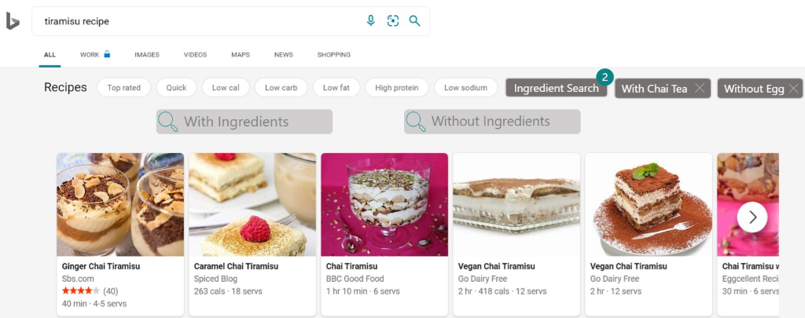
Specs/Mocks
Ingredient Search Spec (Web view)

Slide 55
Problem/Motivation
Some users may not want to go through recipes that they won't be able to make with ingredients they have on hand.
In a Microsoft study, 25% of participants chose a recipe in the Bing experience based on specific ingredients (e.g., sour cream, beef).
To include a long list of ingredients you have on hand in the search bar, as with the last point, can be tedious and may not trigger the recipe experience.

Slide 56
Problem/Motivation
There are many "superfoods" that exist for all diets that a user may want to include in their search to find recipes with these health benefits.
Sweet potatoes are considered a superfood for diabetics by the American Diabetes Association.

Slide 57
Goal
No. | Goal | Pri.
1 | Allow users to specifically refine search based off ingredient inclusions and exclusions | P0
2 | Extending the ingredient search for multiple ingredients | P0
3 | Provide search suggestions for ingredients | P1
The goal of adding an ingredient search is to create a more relevant and engaging experience for users when searching for recipe content. This will be accomplished by:

Slide 58
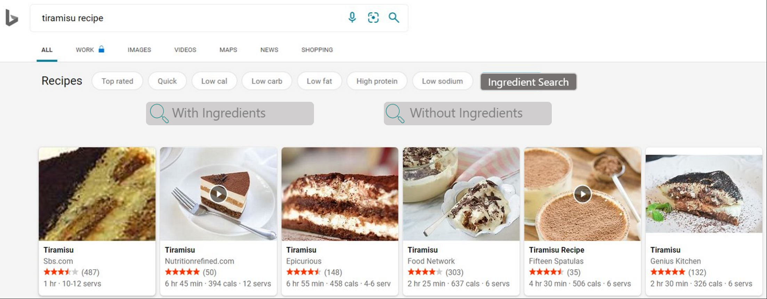
User Scenarios
As a user, I can include or exclude ingredients from my recipe search (P0)
I can navigate to the ingredients tab and search for relevant ingredients

Slide 59
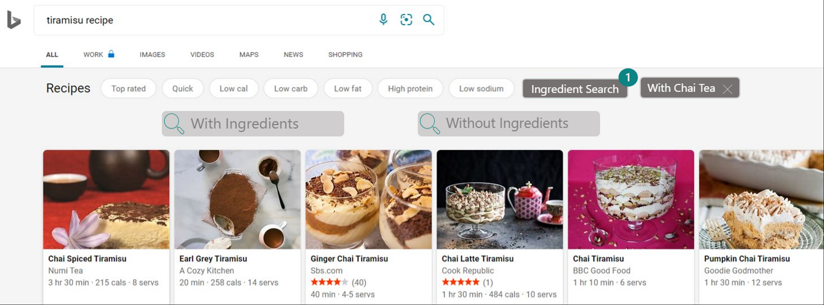
User Scenarios
As a user, I can include or exclude ingredients from my recipe search (P0)
b. Once an ingredient is selected, the ingredient can be found at the top of recipe experience, and the ingredient search bar becomes empty again

Slide 60
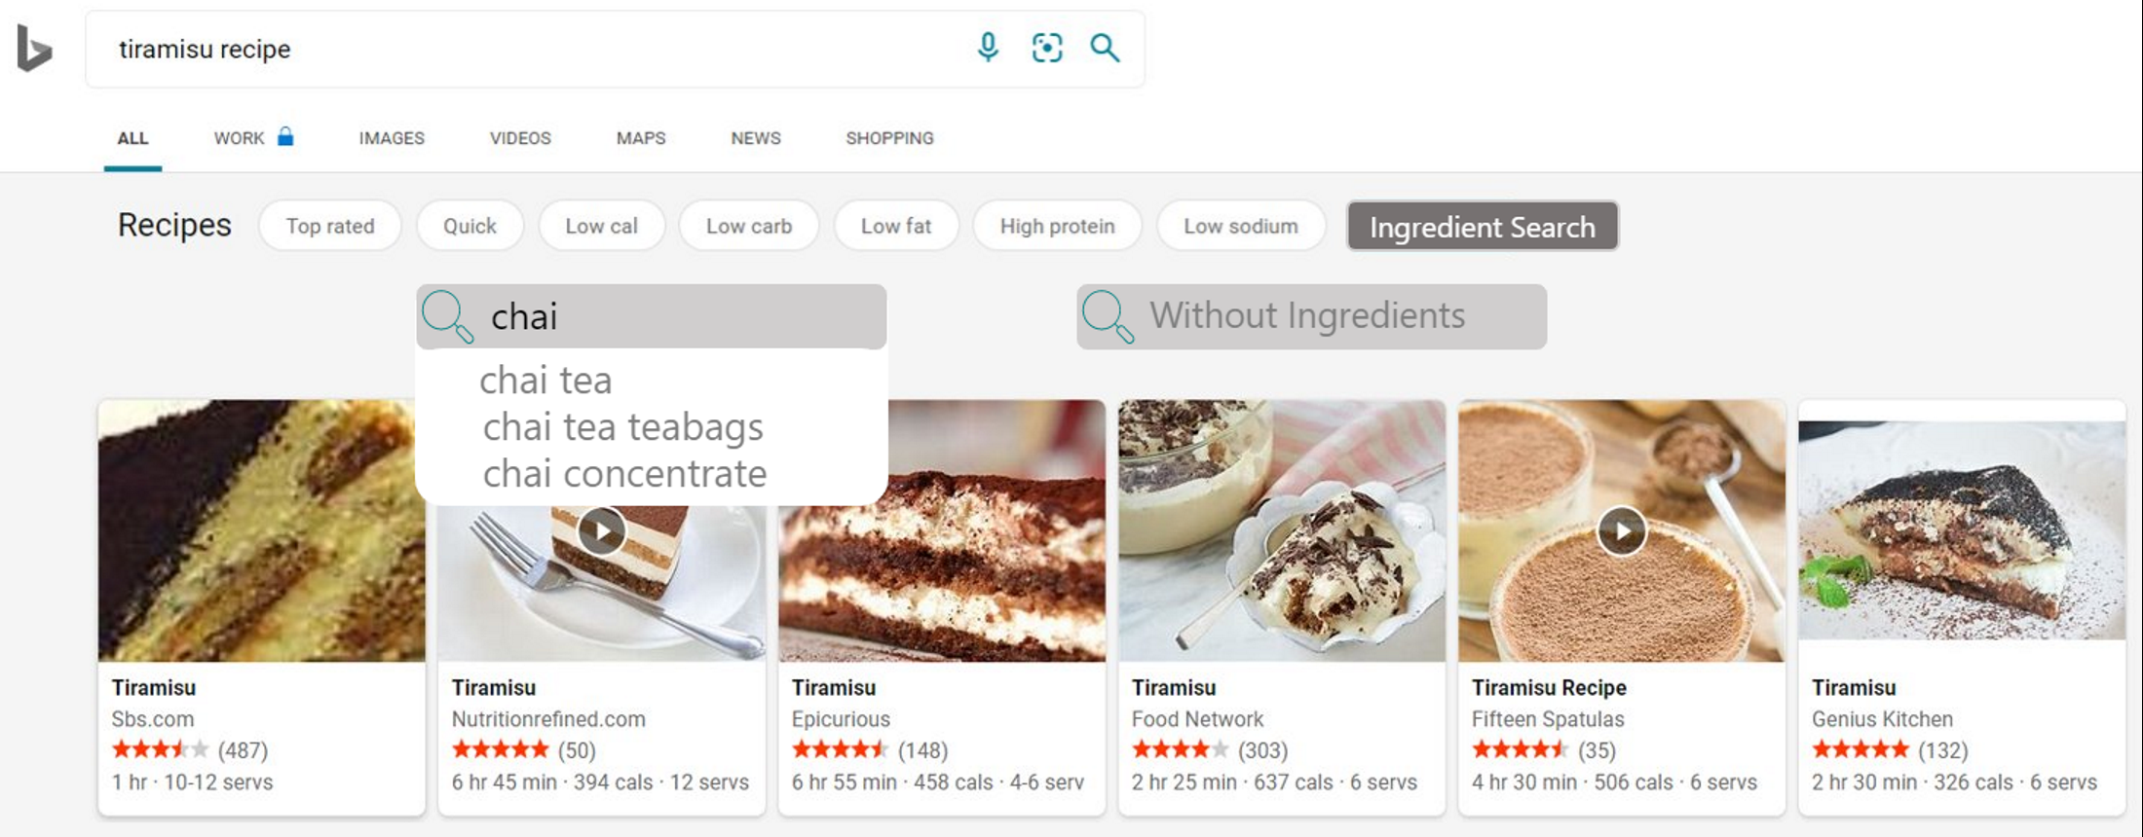
User Scenarios
2. As a user, I can choose the ingredient I want from a list of search suggestions (P1)

Slide 61
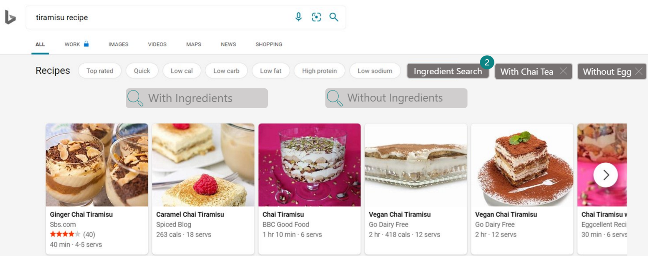
User Scenarios
3. As a user, I can choose to include or exclude multiple ingredients (P0)

Slide 62

Results
Our two features are being incorporated into the Recipe Visual SERP

Slide 63
Overview FR/DE
MEPM Market Review
Competitive Analysis

Slide 64

MEPM Market Review
Websites provided by MEPMs (Universal Region Insights - Recipe.xlsx)
Data taken from Statista (Food Consumption Trends and Eating Habits)
Notes:
Each year, approx 45 million Americans go on a diet
22.8 million Americans follow a vegetarian-inclined diet
7.3 million Americans follow a vegetarian-based diet
1 million Americans are vegan
In a Microsoft study, 15% participants said that diet filters were the most useful feature on their preferred site
Approx 32 million people in the US have food allergies
Food allergies on the rise
childhood peanut or tree nut allergy appears to have more than tripled between 1997 and 2008
between 1997-1999 and 2009- 2011, food allergy prevalence among children increased by 50%
In a Microsoft study, 10% participants found searching by ingredients to be the most useful feature on their preferred site
Competitive Analysis EN-US.pptx

Slide 65
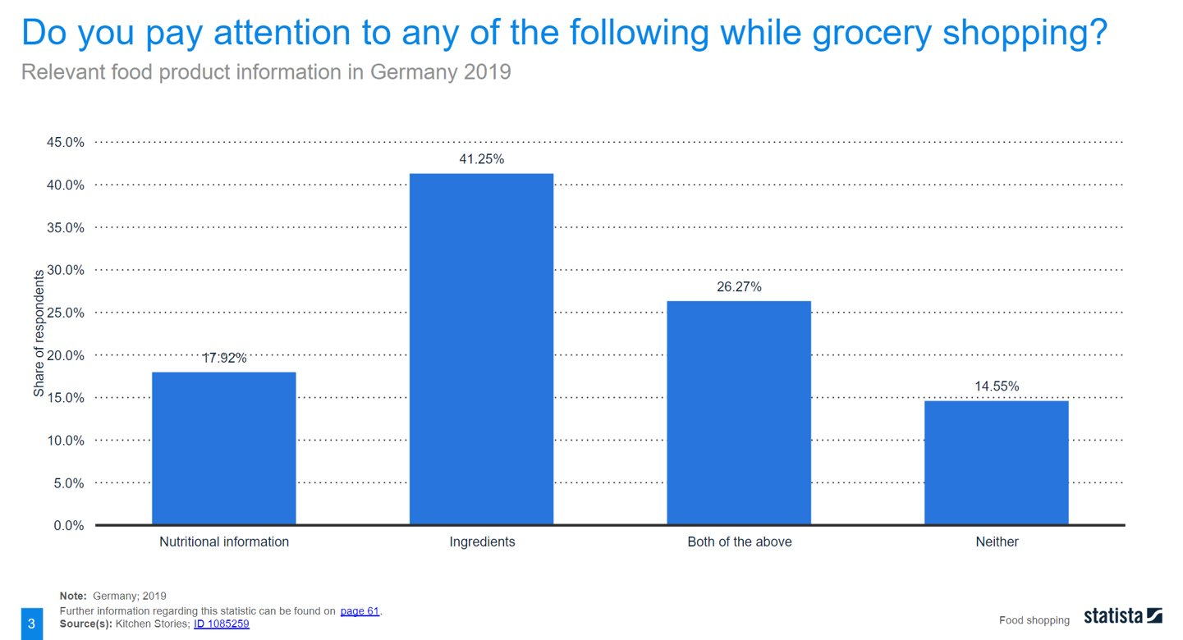
MEPM Market Review

Slide 66
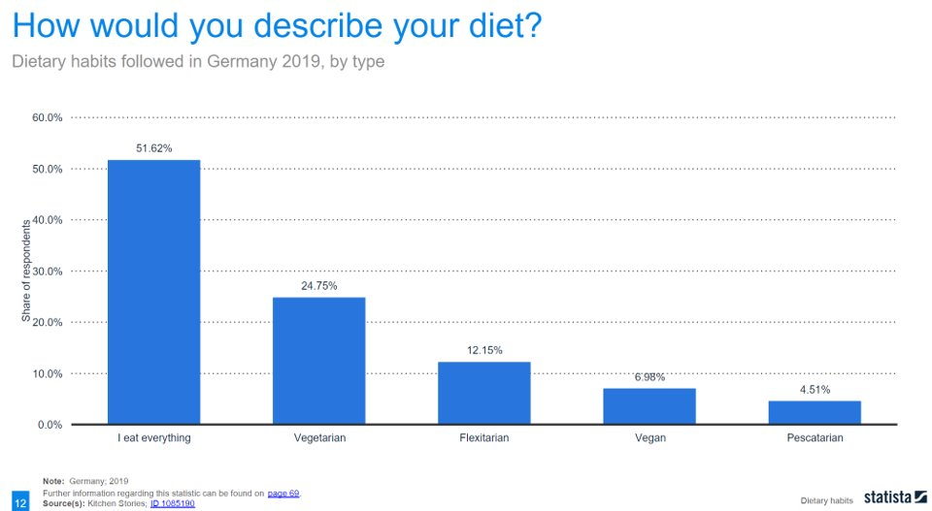
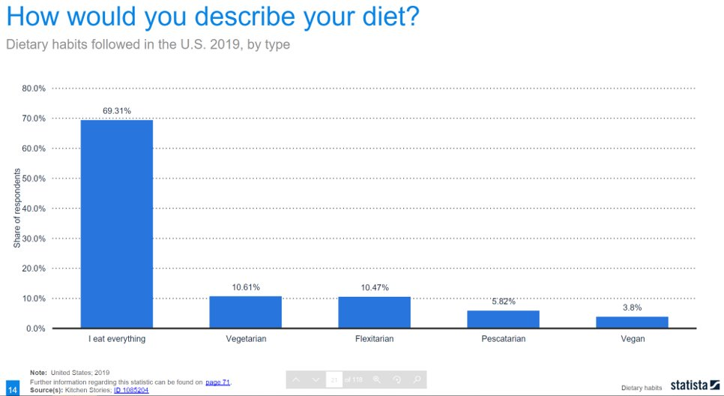
MEPM Market Review

Slide 67
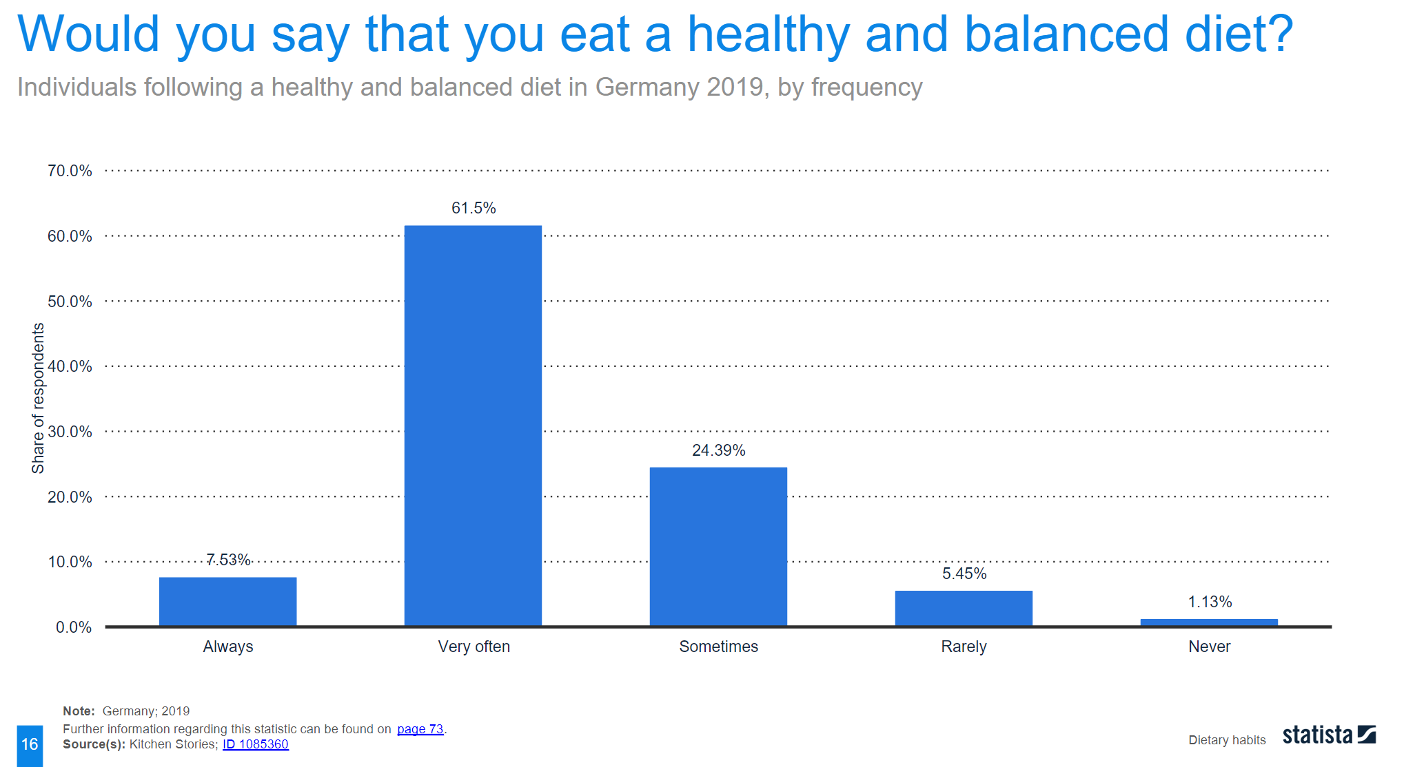
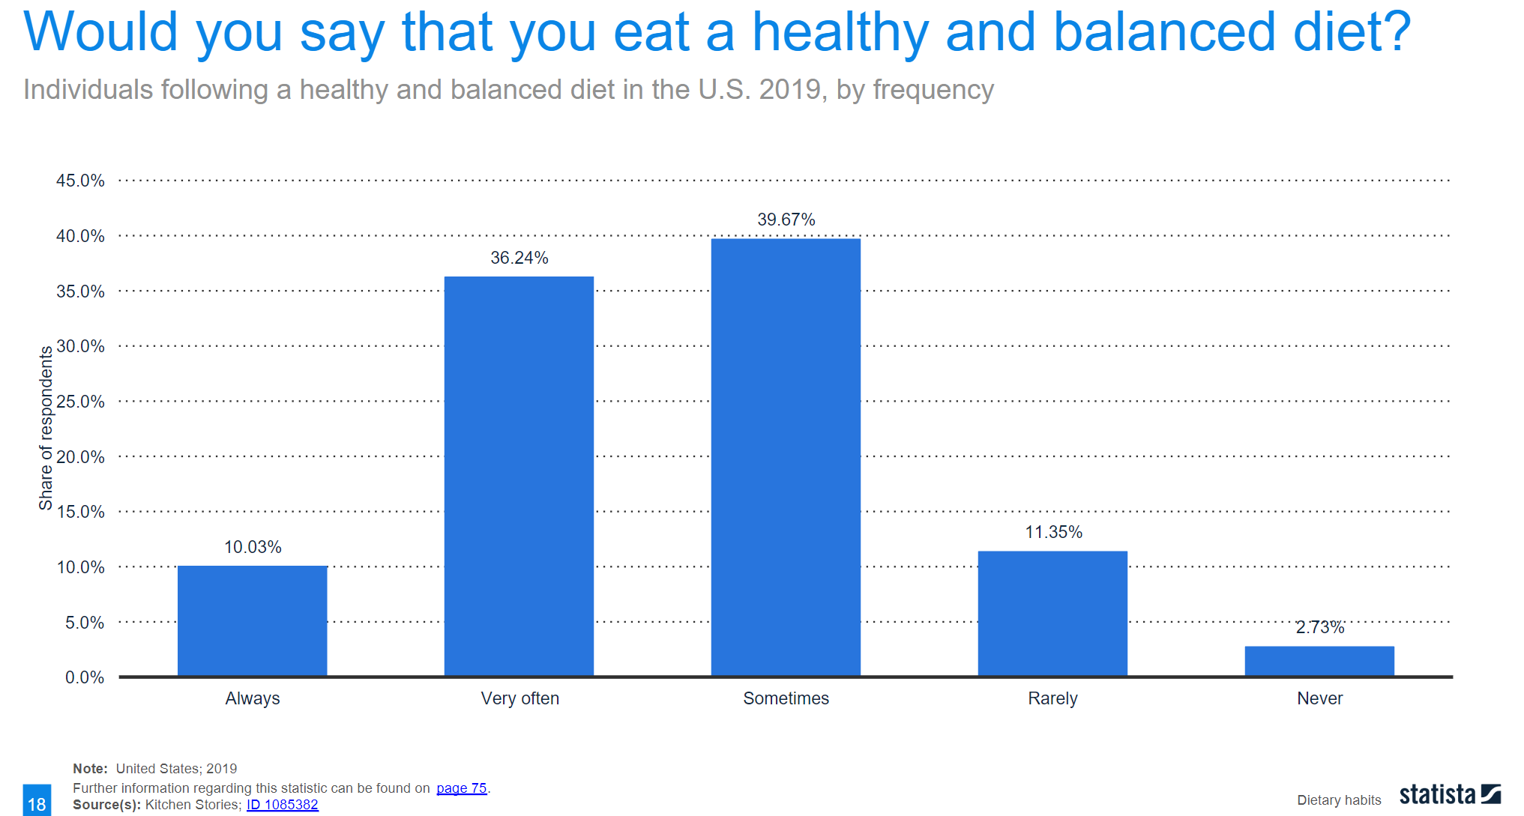
MEPM Market Review

Slide 68
FR/DE Competitive Analysis
Ingredient Search
Categories & Filters
Saving Recipes
Related Searches

Slide 69

Comparison
​ | EN-US​ | FR​ | DE​
Ingredient Search​ | ​ | ​ | ​
Seasonal Categories​ | ​ | ​ | ​
Dish Type Categories​ | ​ | ​ | ​
Technique Categories​ | ​ | ​ | ​
Diet Categories​ | ​ | ​ | ​
Difficulty Filters​ | ​ | ​ | ​
Preparation Time Filter​ | ​ | ​ | ​
​ | ​ | ​ | ​
​ | ​ | ​ | ​
Ingredient Filter​ | ​ | ​ | ​
Culture/Origin​ | ​ | ​ | ​
Saving Recipes​ | ​ | ​ | ​
Related Searches​ | ​ | ​ | ​

Slide 70
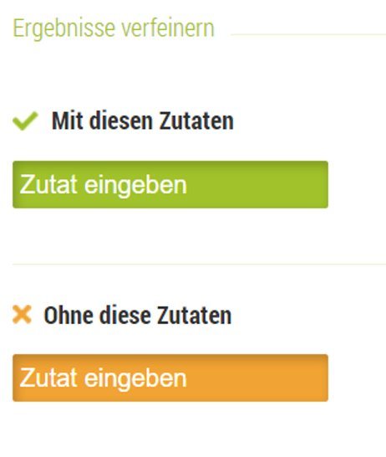
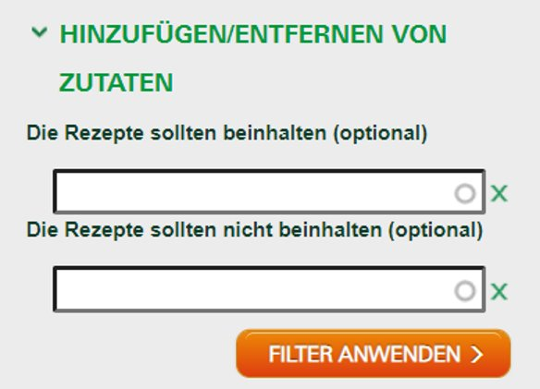
Ingredient Search
Kochbar (DE)
Rezeptwelt (DE)

Slide 71
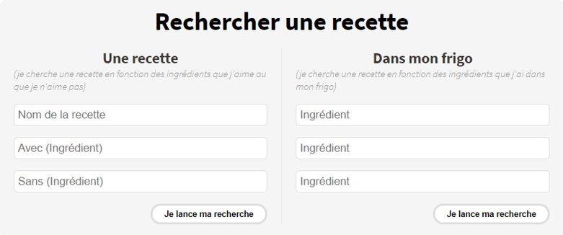

Ingredient Search
Marmiton (FR)
Cuisine Actuelle (FR)

Slide 72
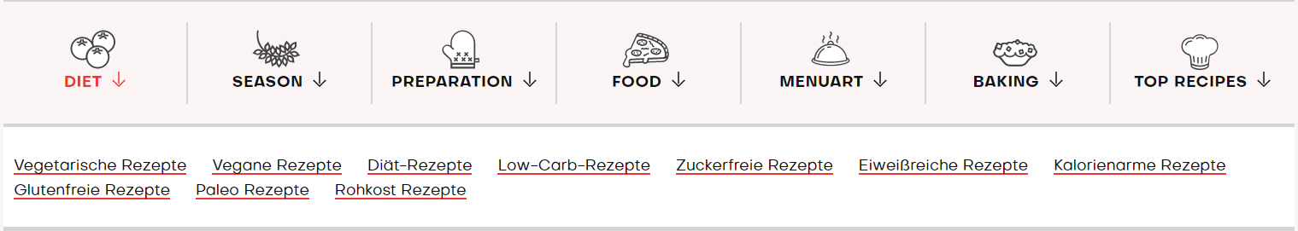
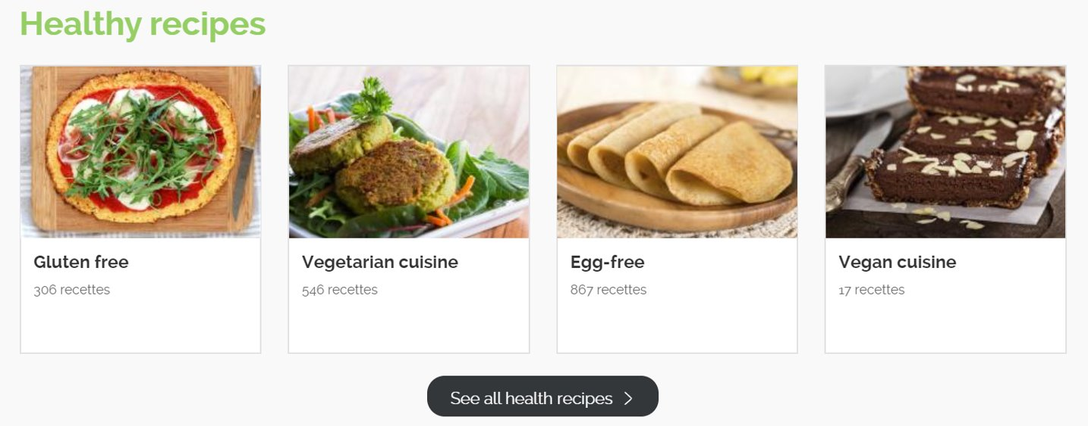
Diet Categories
Brigitte (DE)
750g (FR)

Slide 73

Diet Categories
Other Websites that Feature Diet Categories:
Chef Simon (FR)
essen & trinken (DE)
Küchen Götter (DE)
Chef Koch (DE)
Notes:
Each year, approx 45 million Americans go on a diet
22.8 million Americans follow a vegetarian-inclined diet
7.3 million Americans follow a vegetarian-based diet
1 million Americans are vegan
In a Microsoft study, 15% participants said that diet filters were the most useful feature on their preferred site
Approx 32 million people in the US have food allergies
Food allergies on the rise
childhood peanut or tree nut allergy appears to have more than tripled between 1997 and 2008
between 1997-1999 and 2009- 2011, food allergy prevalence among children increased by 50%
In a Microsoft study, 10% participants found searching by ingredients to be the most useful feature on their preferred site
Competitive Analysis EN-US.pptx

Slide 74
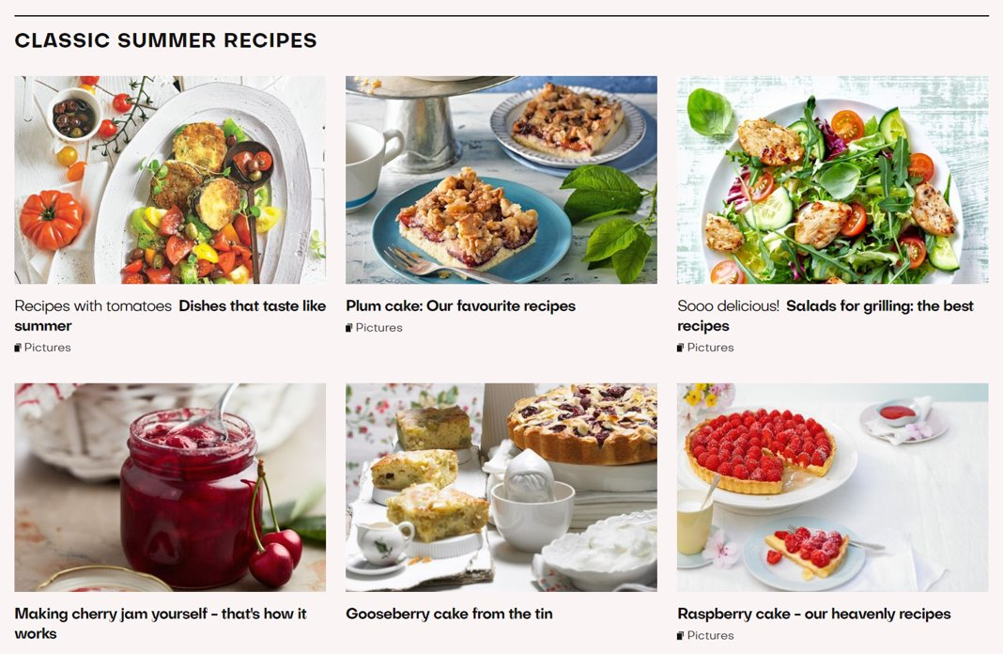
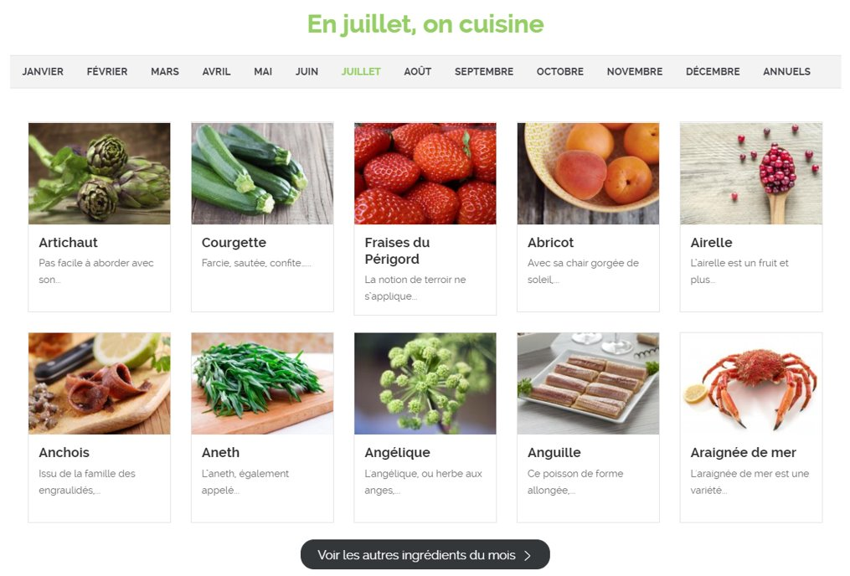
Seasonal Categories
Brigitte (DE)
750g (FR)

Slide 75
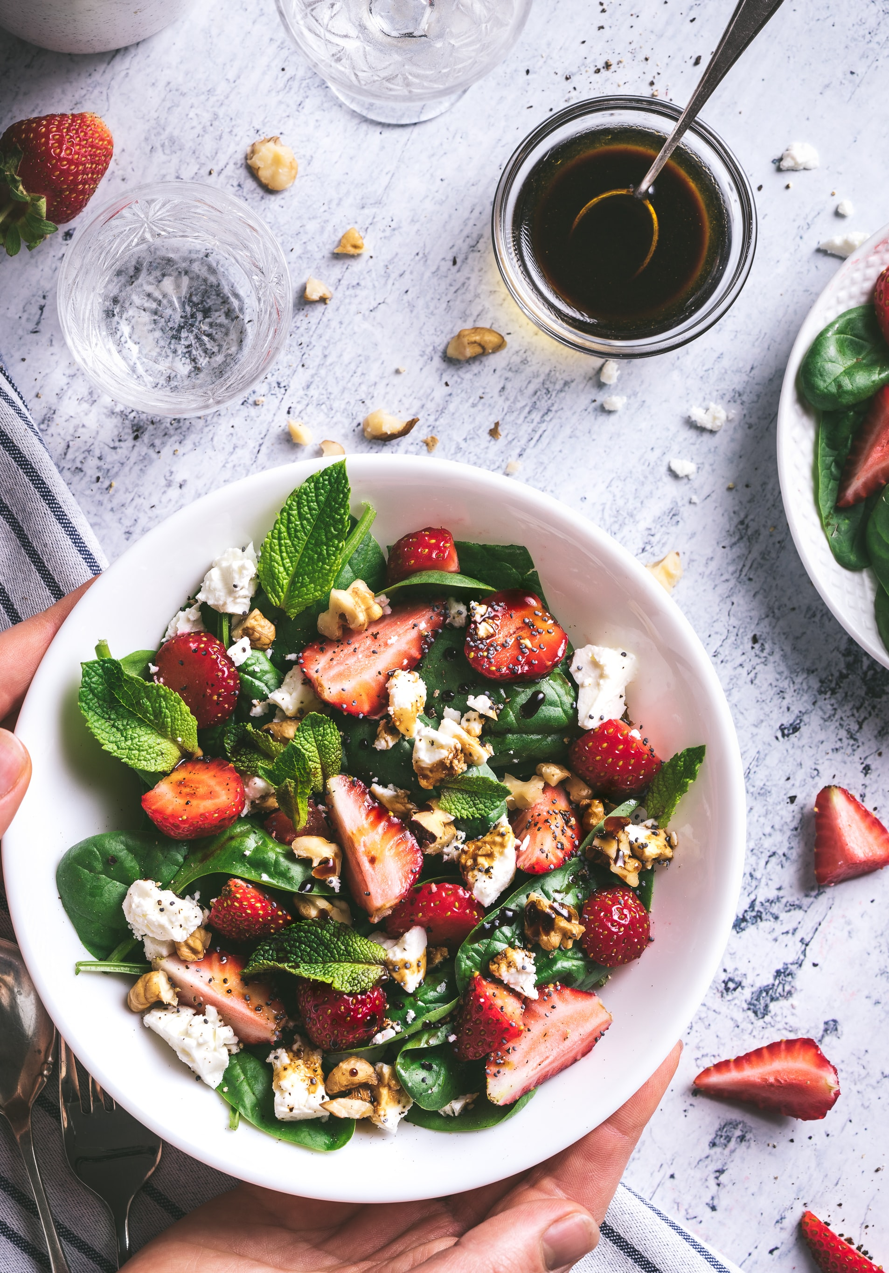
Seasonal Categories
Other Websites that Feature Seasonal Content
Marmiton (FR)
Chef Simon (FR)
Chef Koch (DE)
kochbar (DE)
essen&trinken (DE)
Lecker (DE)
Küchen Götter (DE)
Rezeptwelt (DE)
Notes:
Each year, approx 45 million Americans go on a diet
22.8 million Americans follow a vegetarian-inclined diet
7.3 million Americans follow a vegetarian-based diet
1 million Americans are vegan
In a Microsoft study, 15% participants said that diet filters were the most useful feature on their preferred site
Approx 32 million people in the US have food allergies
Food allergies on the rise
childhood peanut or tree nut allergy appears to have more than tripled between 1997 and 2008
between 1997-1999 and 2009- 2011, food allergy prevalence among children increased by 50%
In a Microsoft study, 10% participants found searching by ingredients to be the most useful feature on their preferred site
Competitive Analysis EN-US.pptx

Slide 76
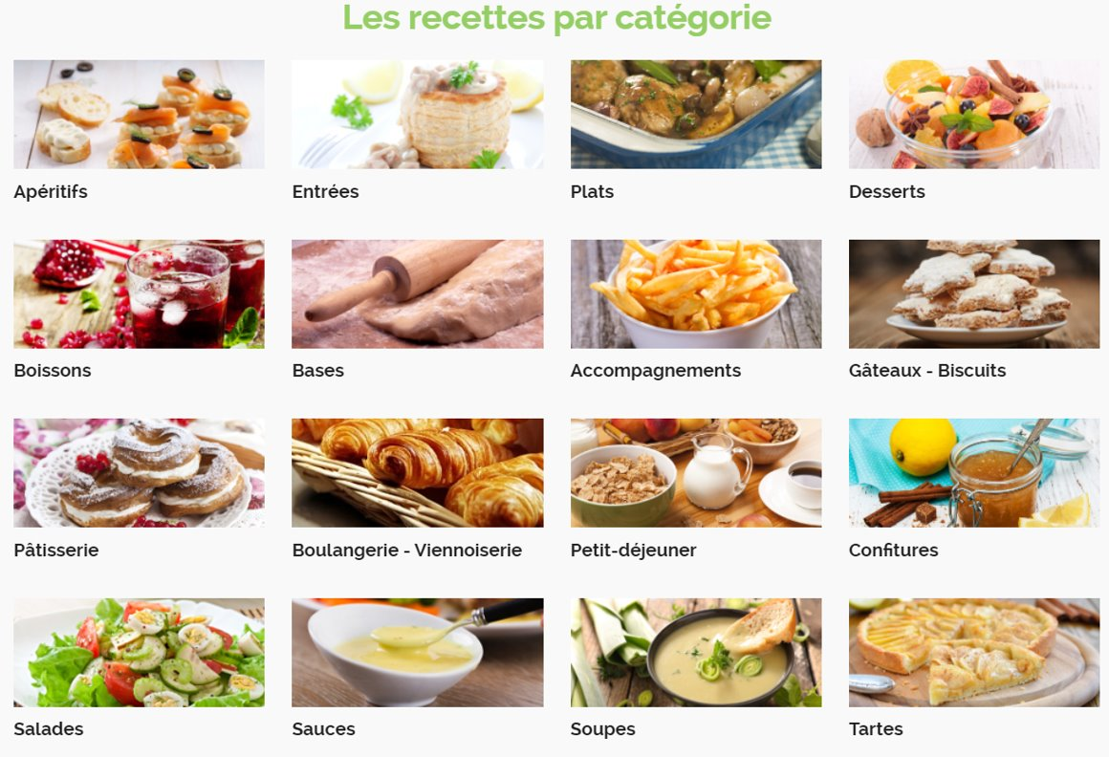
Dish Type Categories
Most Common French Dish Type Categories
Apéritif- a drink taken before a meal to stimulate the appetite
Entrée
Plat
Dessert
Boisson
Sauce

Slide 77



Technique Categories
Brigitte (DE)
Chef Koch (DE)
kochbar (DE)

Slide 78

Filters
Cuisineaz (FR)
Other filters not shown:
Preparation
Cost
Ingredient
Festivity
Categories under sort by:
Relevance
Difficulty
Cost
Preparation Time
Date Added

Slide 79


Filters
Lecker (DE)
Like many other FR-DE websites, Lecker includes categories for the type of meal
Lecker also includes the nationality/cultural origin of food to filter
Very limited diet options

Slide 80

Filters
Bing
Limited amount of filters
Touch filters mainly revolve around nutrition and rating/quick
No options for difficulty, preparation time, ingredient, and culture/origin

Slide 81

Saving Recipes
Chef Koch (DE)
Once you open the full recipe, below the image or video there is an option to save your recipe to a cookbook
The save button is very prominent and easy to notice

Slide 82

Saving Recipes
Chef Koch (DE)
You can sort your cookbook into collections and easily move, delete, or copy recipes
You can add private recipes to your cookbook
There is also the option to create group cookbooks with friends on the platform
Clicking on the recipe navigates you directly to its full page

Slide 83


Related Recipes
Chef Koch (DE)
Bing

Slide 84
Related Documents
Competitive Analysis EN-US.pptx
Feature Ideation Deck.pptx
Diet/Allergen Filter Spec (Web view)
Ingredient Search Spec (Web view)
Universal Region Insights - Recipe.xlsx
Food Consumption Trends
Eating Habits
FR/DE Competitive Analysis.pptx

Slide 85
Thank you

